Slide 1

Comparison of Music Taste Across Regions and Generations
Eduardo Armenta, Brendan Baker, Brian Wimmer

Slide 2
Agenda
Introduce Topics
US vs UK Top 50
Evolution Across Decades
US vs Mexico Top 50
Predicting Popularity
Conclusion

Slide 3





Topics
US vs UK
Comparing if there are differences between music preferences
Decade vs Decade
Looking into each of the past 7 decades and the evolution of music
US vs Mexico
Comparing happiness in music across languages and world regions
Predicting Popularity
Understanding if song popularity comes from tangible features or abstract concepts
3

Slide 4
US vs UK
Do the characteristics of popular songs vary between countries that speak the same language?
4

Slide 5
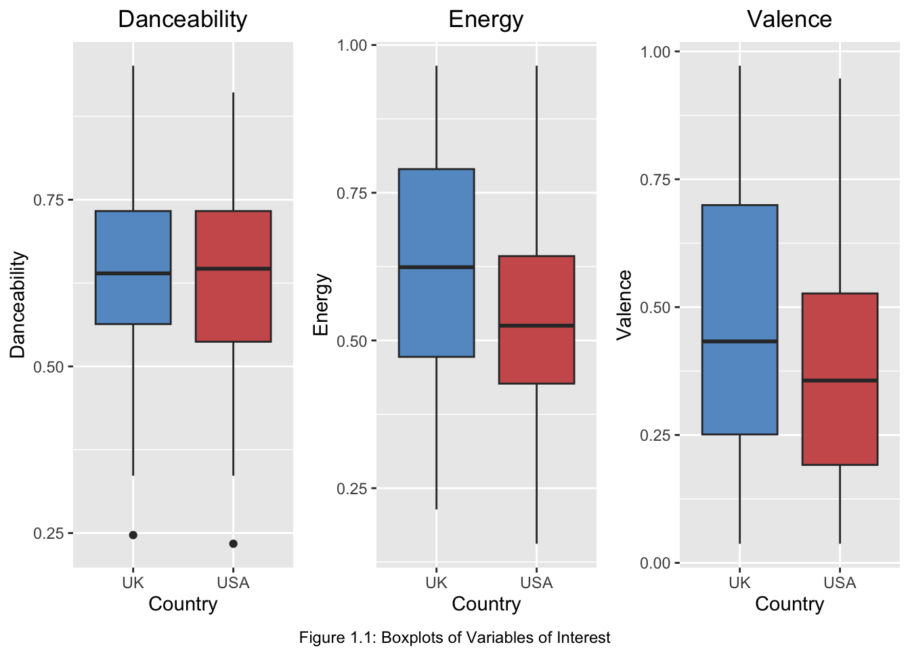
EDA
Observations
Danceability: minimal difference between countries
Energy: significant variation, UK ~20% higher
Valence: similar variation as Energy
UK Energy and Valence interquartile range is broader
5

Slide 6
Testing: two sample t-test
Experiment results:
Hypotheses
Variable
P-value
Results
Null: the mean of the tested variable for the US is the same as that for the UK
Alternative: the mean of the tested variable is larger for the UK than that of the US
.31
Failed to reject the null hypothesis. UK and US means are too similar
Fail
Danceability
.01
Reject the null hypothesis. UK mean is higher than the US mean
Reject
Energy
.03
Reject the null hypothesis. UK mean is higher than the US mean
Reject
Valence
6

Slide 7
Conclusion
Although we expected each variable to have higher means for the UK than the US, only Energy and Valence had significantly greater averages
From this, we can conclude that there is a difference in music characteristics among countries that speak the same language

Slide 8
Decades
Has music become louder over time?
8

Slide 9
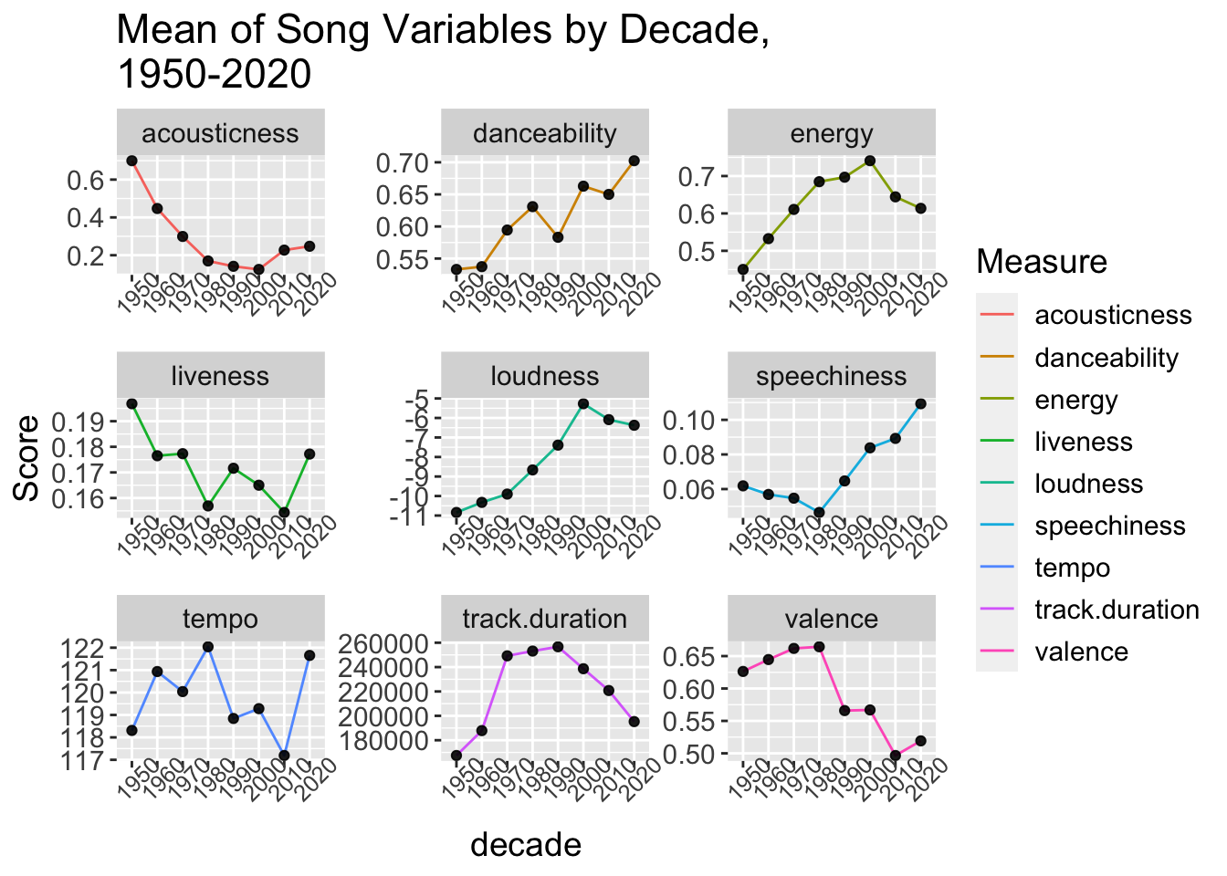
EDA
Key observations
There are clear differences among the variables scores across all decades
Loudness presented a clear trend going upward
Selected to analyze loudness due to its objective nature (decibels)
9

Slide 10
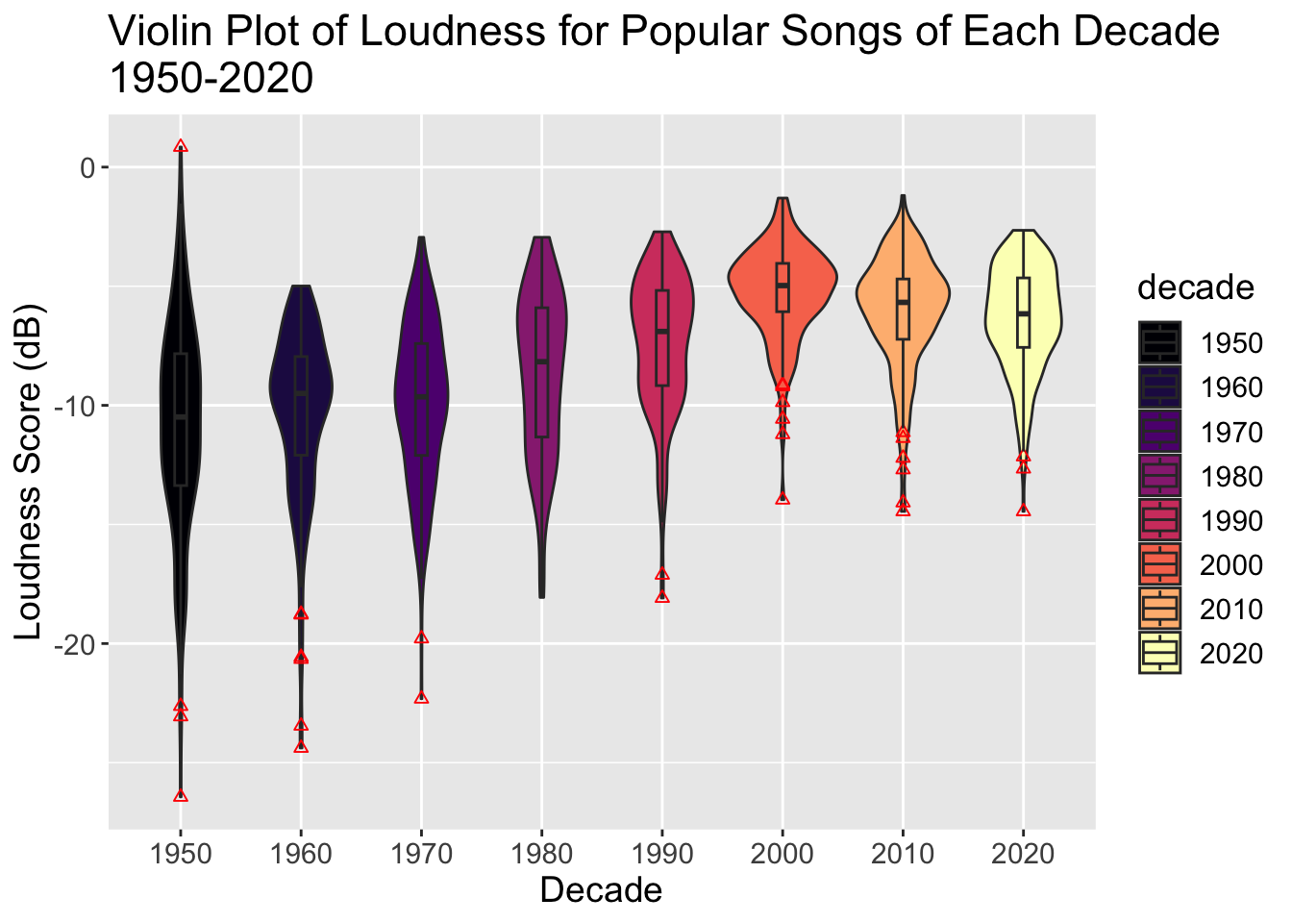
EDA
Key observations
Loudness dispersion throughout songs gets tighter around the mean across the decades
Distributions are mostly Gaussian, with some decades being somewhat skewed
10

Slide 11
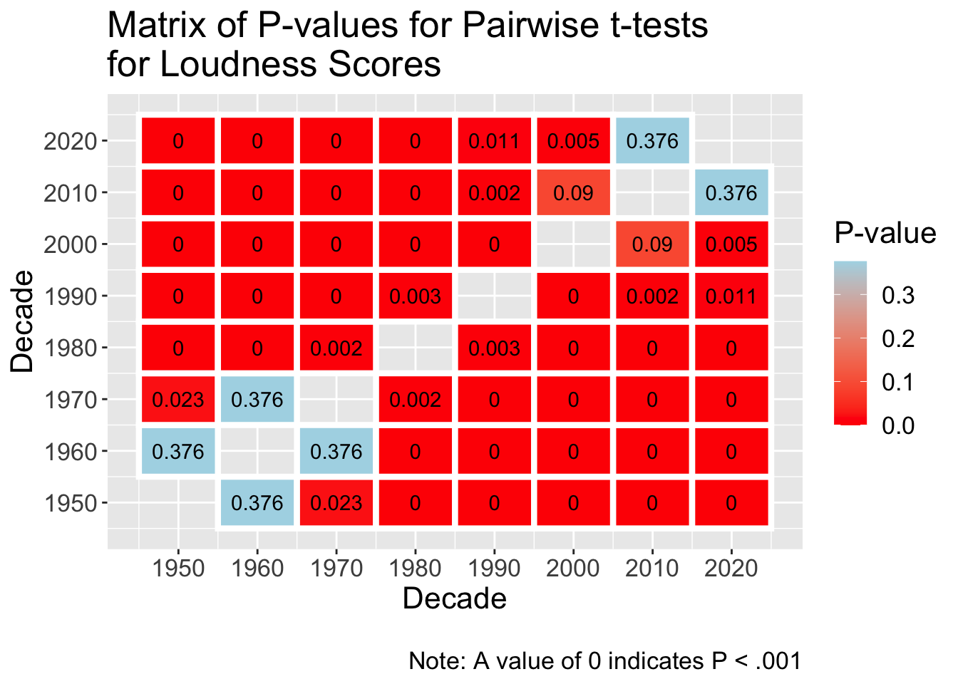
Testing: ANOVA, Pairwise t-test
ANOVA hypotheses
ANOVA
F-statistic | 76.8 | P-value | < 0.001
Null: No difference in the loudness score between decades
Alt: mean loudness scores are not equal
Pairwise t-test hypotheses
*
Null: no difference between loudness score between some decade X and Y
Alt: the difference between loudness scores is not zero
*Hochberg adjustment
11

Slide 12
Conclusion
Initially, we expected the loudness score to increase as the years went by, but after exponential growth, it peaked in the 2000’s and began trending downwards
We can conclude that music does change throughout the decades, but old trends get reused and the change is always influenced by music of the past

Slide 13
US vs Mex
Does music in Mexico’s Top 50 playlist tend to be more danceable and happy than the US counterpart?
13

Slide 14
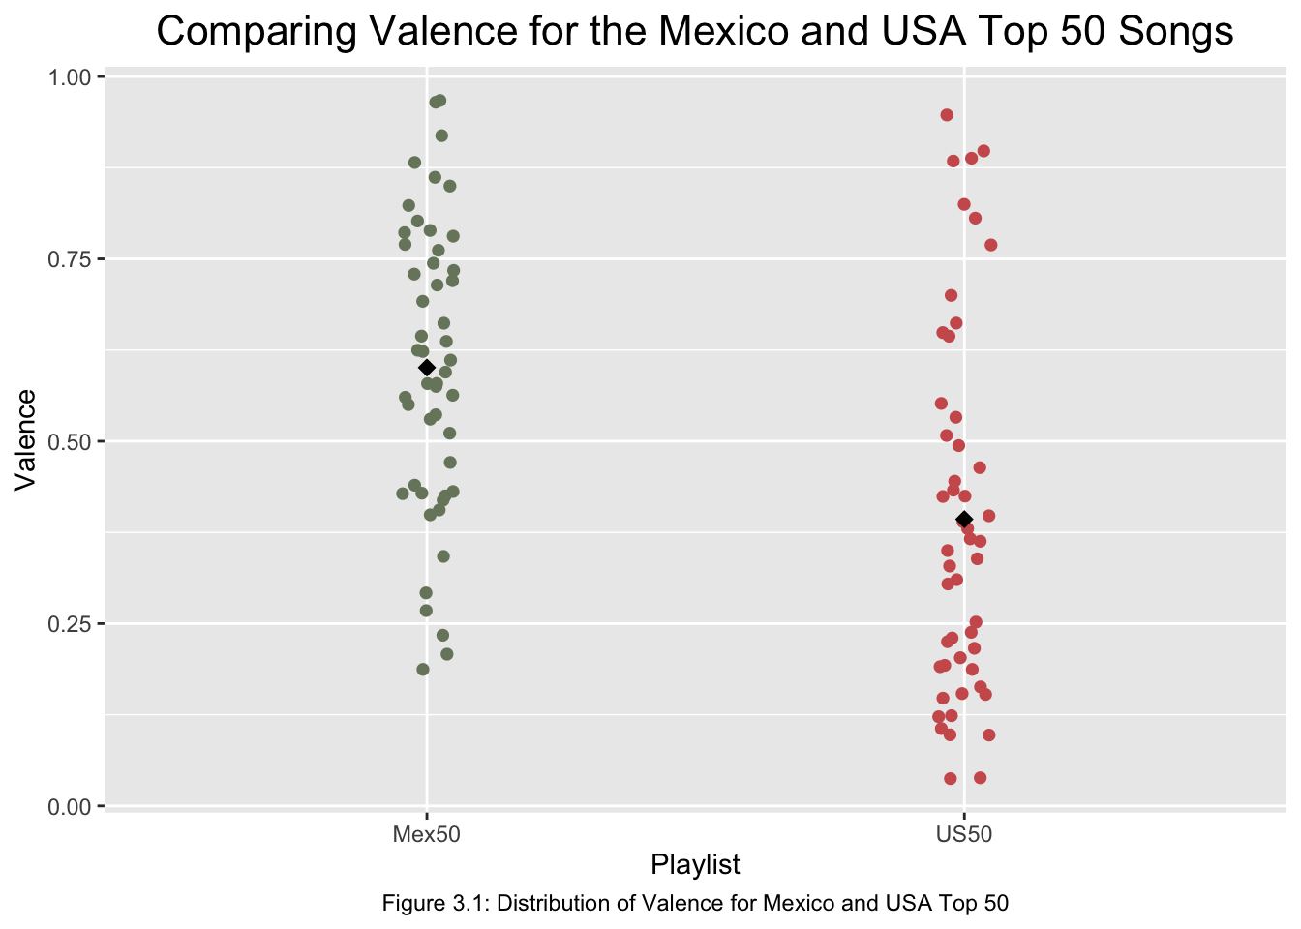
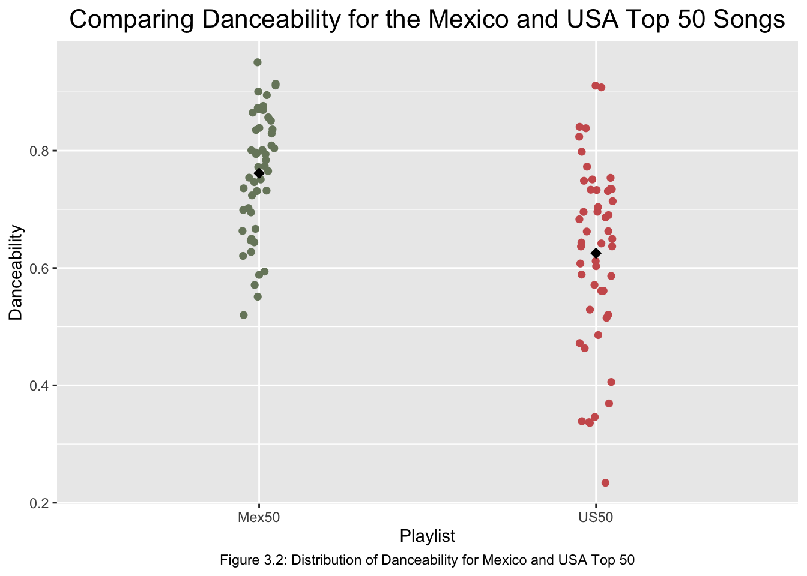
EDA
Key observations
Both Valence and Danceability means for Mexico’s Top 50 music are greater than the US
The danceability scores for Mexico’s Top 50 are more compact around the mean
This leads us to believe that our hypothesis will be true
14

Slide 15
Testing: MANOVA
MANOVA hypotheses
Null: Danceability and Valence scores are not dependent on the playlist label
Alt: Danceability and Valence scores are dependent on their playlist label
MANOVA
Variable | Metric | Value
Danceability | p-value | < 0.001
Valence | p-value | < 0.001
15

Slide 16
Conclusion
We found that mean scores for Valence and Danceability are higher for Mexico’s Top 50 playlist than the means for those of the US Top 50 playlist
We think this could be due to Spanish being a warmer language and movement being an important part of Mexican expression

Slide 17
Predict Popularity
Are there any song characteristics that can help us predict popularity scores?
17

Slide 18
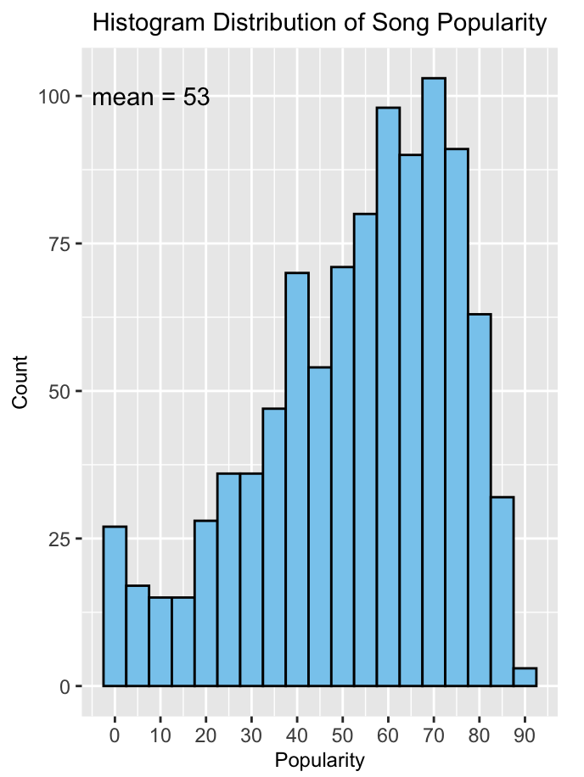
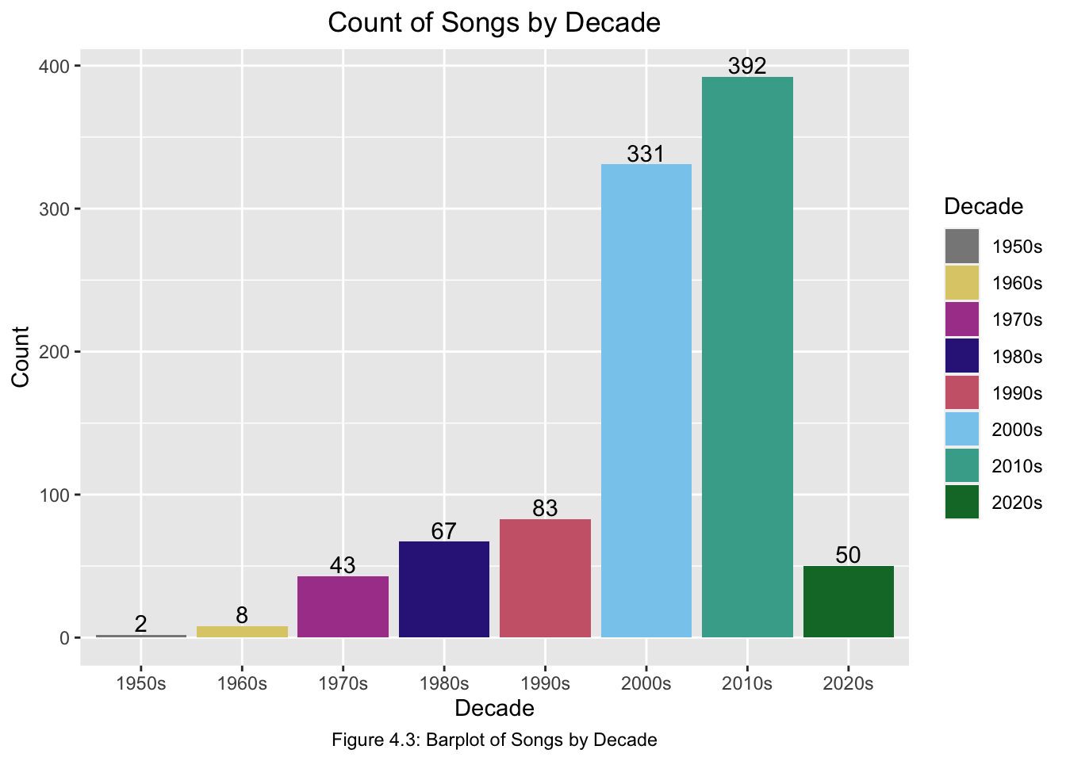
EDA
Key observations
Popularity’s distribution is left skewed and has a mean of 53
Songs in this playlist tend to have a relatively high popularity score
Most songs come from the time period 2000-2020, which means we have unbalanced data
18

Slide 19
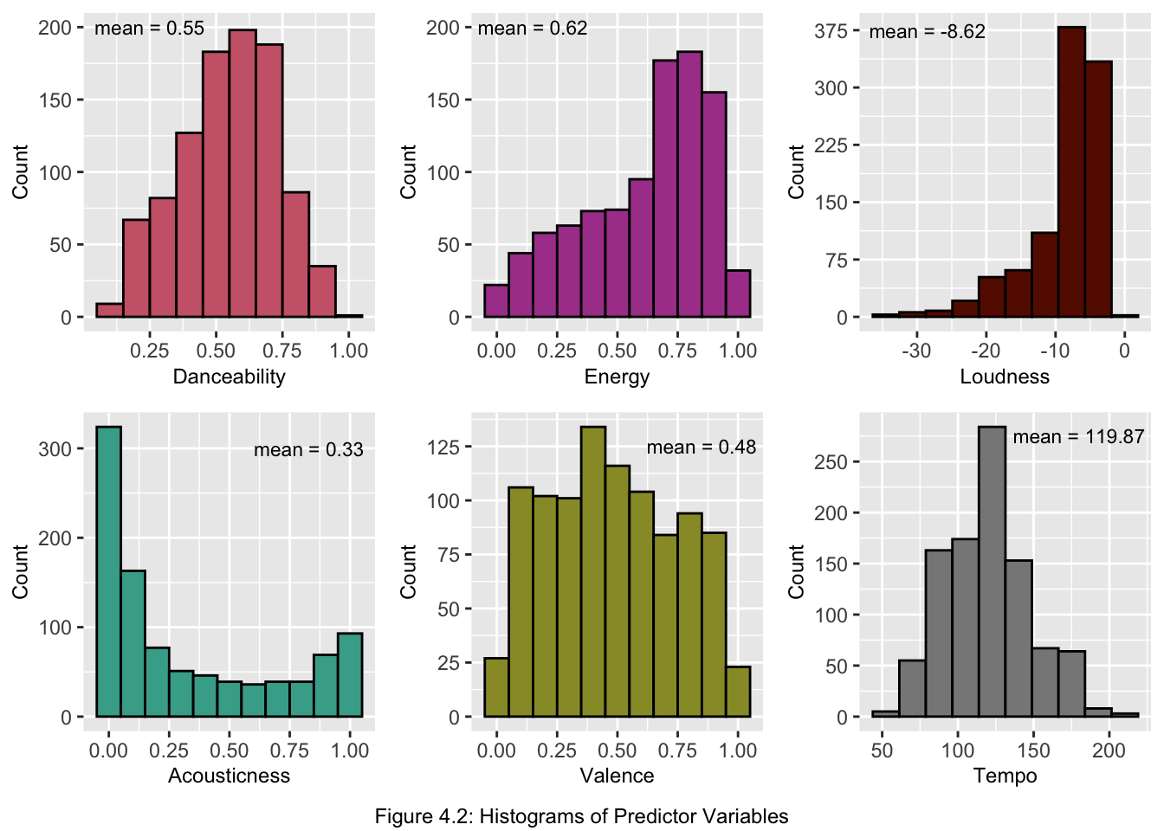
EDA*
Key observations
Data isn’t balanced across all variables
Loudness has a high mean and strongly skewed to the left
Danceability gets closest to a normal distribution
Valence is mostly like a uniform distribution
*Some variables omitted from EDA
19

Slide 20
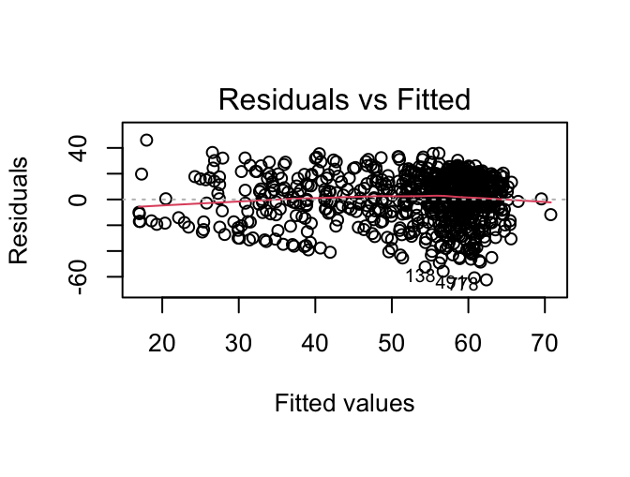
Testing: Regression
Results
R2: 0.24
Significant variables:
Valence
Loudness*Acousticness
Valence*Instrumentalness
Not good at predicting popularity score
Tried 4 models, but they all yielded a similar R2
20

Slide 21
Conclusion
We thought we’d be able to predict popularity scores using some of the data’s variables, but we found that our model is unable to explain the variation of popularity scores
Linear regression is not fit to predict popularity based on the available variables. It’s possible that another model could decipher what makes a song popular

Slide 22




Music characteristics are not equal within the same language, it depends on culture
Conclusions
Qualities of popular music have evolved across decades and mirrors the culture of the time
Warmer climate might have an effect on music rhythm, lyrics, and tempo
Popularity scores are not tangible, it likely comes from abstract concepts and social climate

Slide 23
Questions or comments?
23

Slide 24
Thanks!
24

